Slide 1
Continuous non-parametric Bayesian networks in Uninet
dan ababei
light twist software

Slide 2
A Bayesian network represents a joint distribution
  Discrete joint distributions
  Continuous joint distributions

Slide 3
A Bayesian network represents a joint distribution
  Discrete joint distributions
  Continuous joint distributions
A Bayesian network consists of
  Qualitative part
  Quantitative part

Slide 4
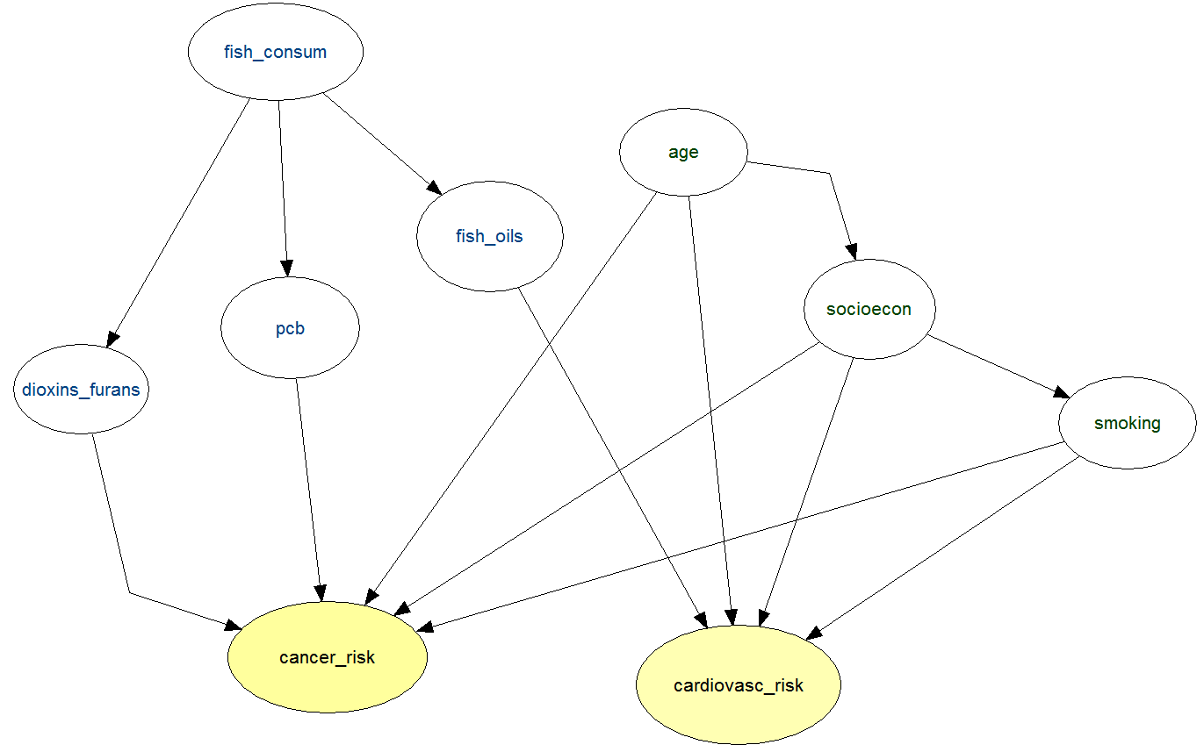
A Bayesian network’s qualitative part is the DAG

Slide 5
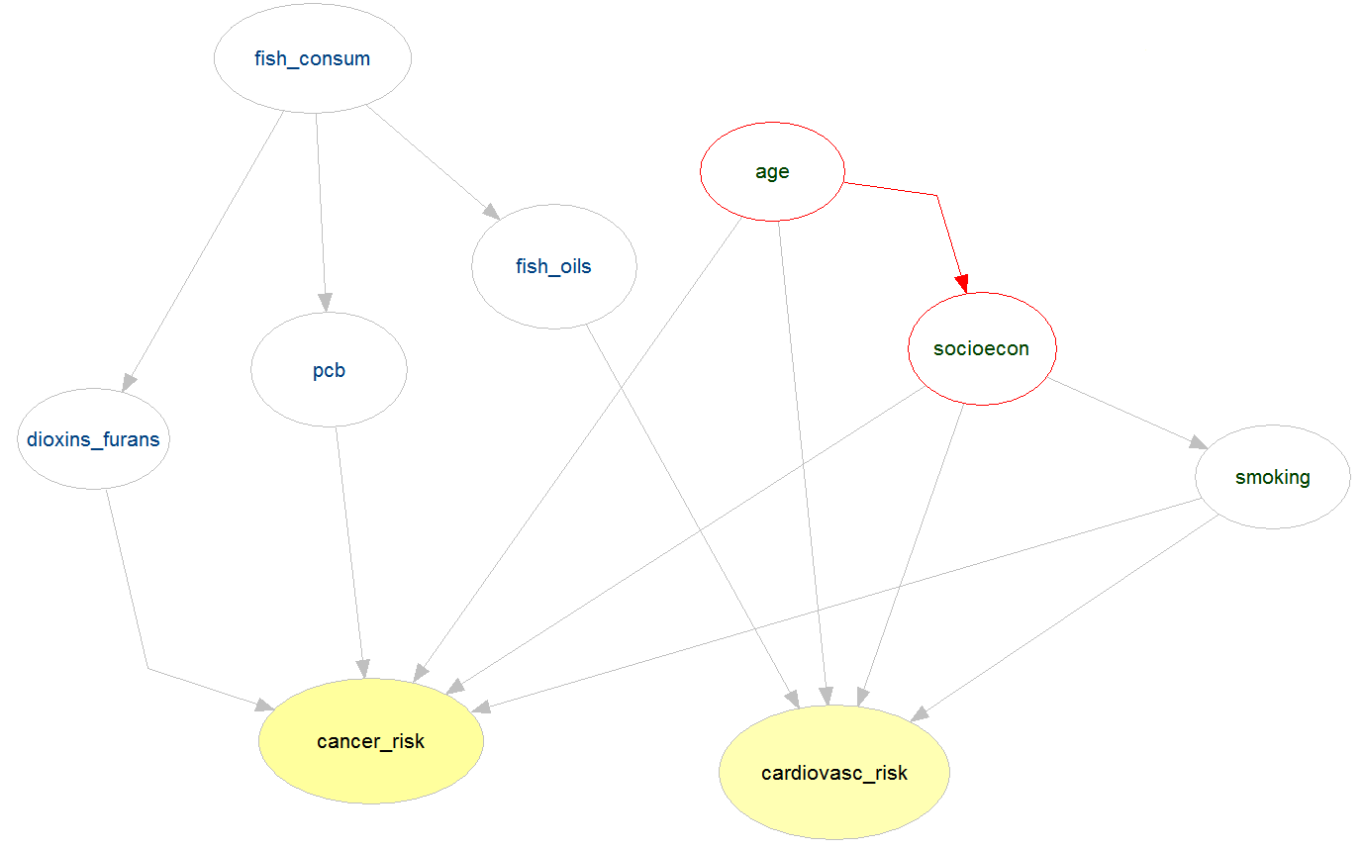
A Bayesian network’s quantitative part is how the nodes and arcs are quantified

Slide 6


Discrete Bayesian network

Slide 7
CPT socioecon | age | sociecon
age | low to middle | upper middle | high | top
very young | 0.79 | 0.19 | 0.02 | 0
young | 0.32 | 0.48 | 0.18 | P(socioecon=top|age=young) = 0.02
mature | 0.03 | 0.28 | 0.6 | 0.09
middle-age | 0 | 0.03 | 0.48 | 0.49
elderly | 0.01 | 0.01 | 0.08 | 0.9

Slide 10
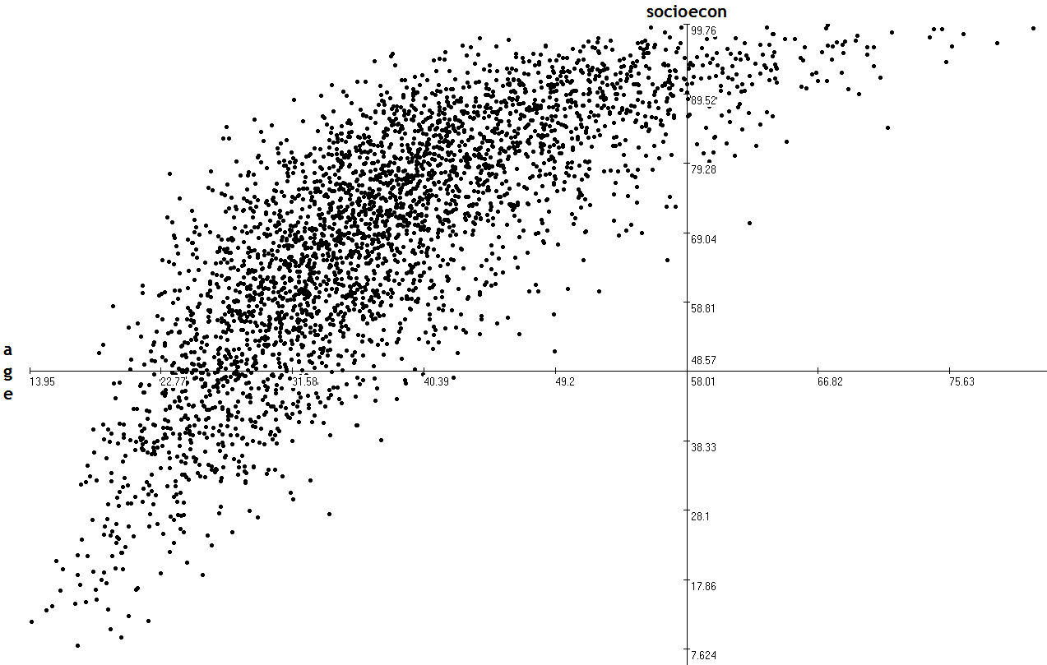

Slide 11
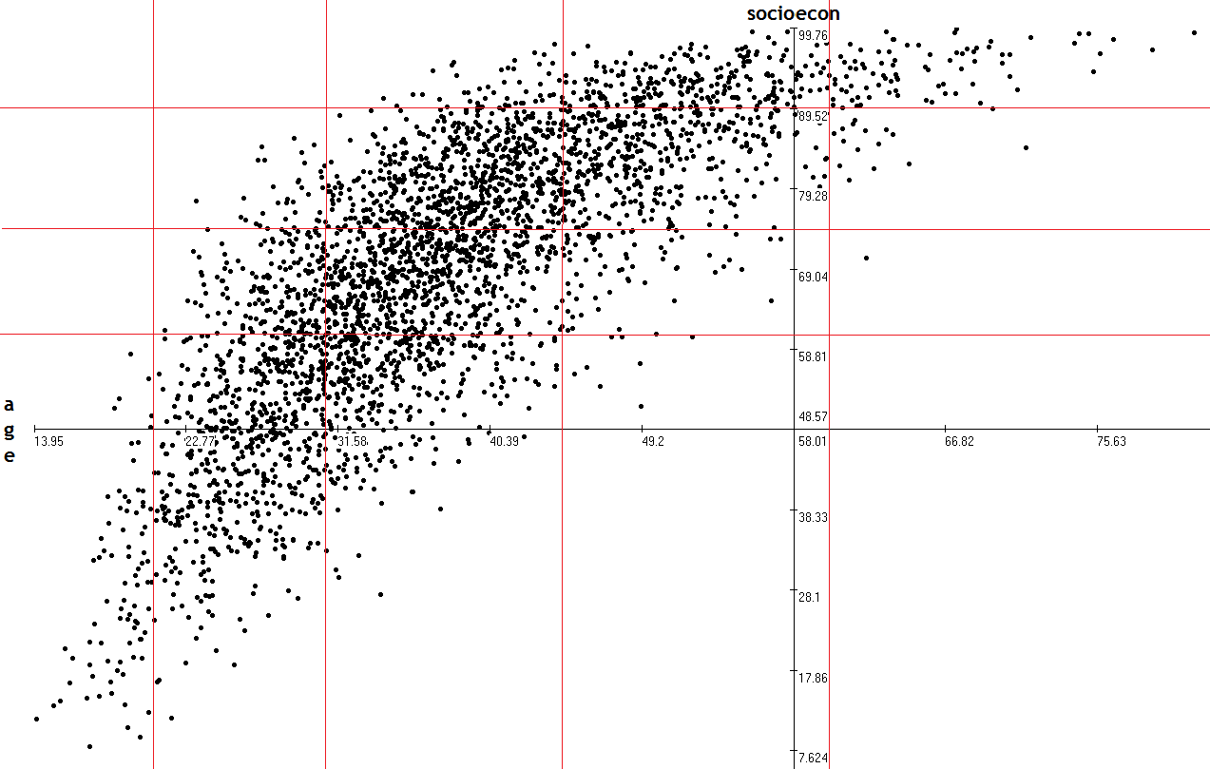

Slide 13
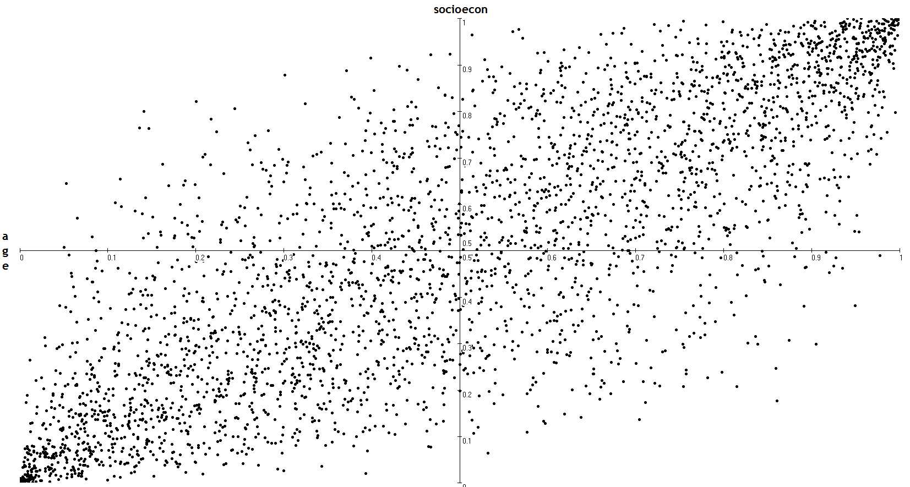
rank correlation

Slide 14
rank correlation
r_{socioecon age} = 0.8

Slide 15
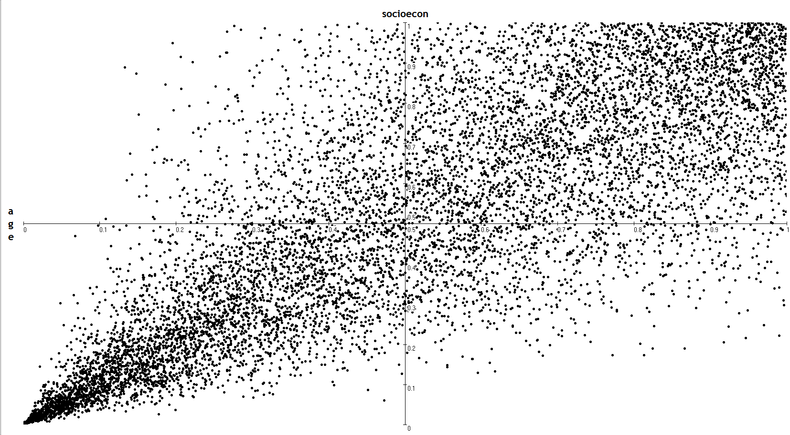
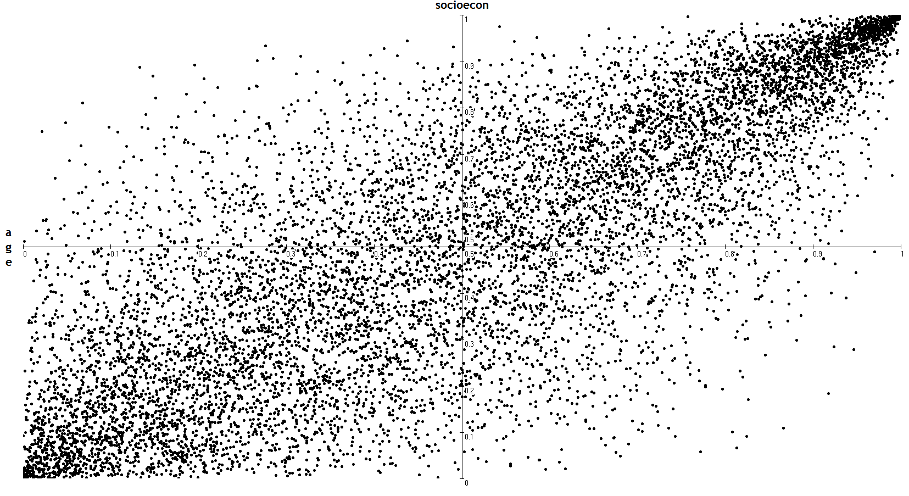
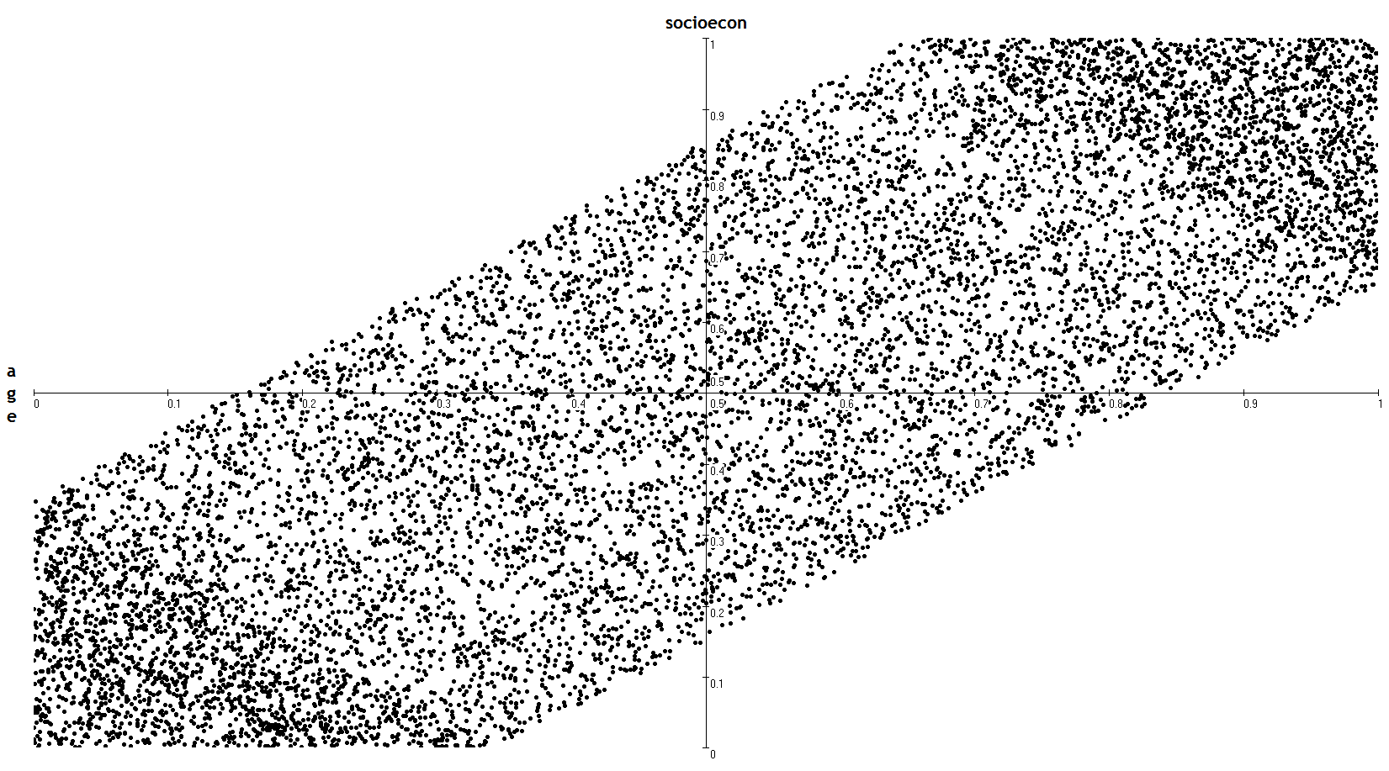
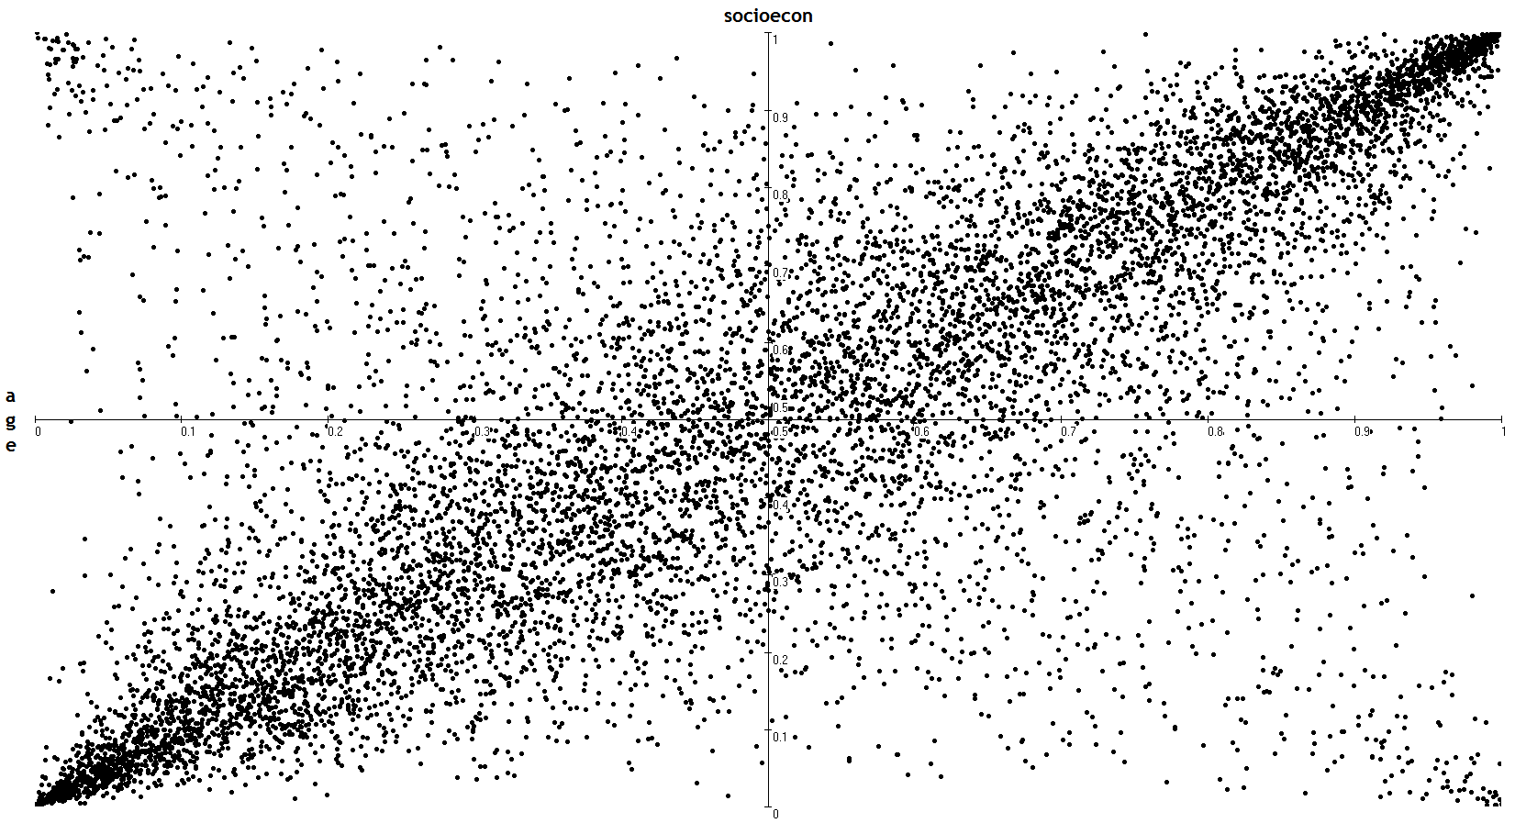
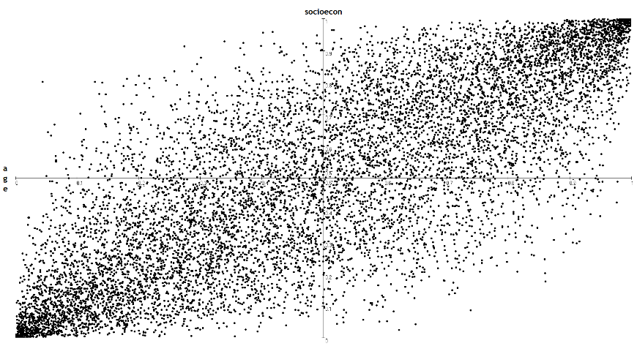
Copulas
Clayton (rank=0.8)
Gumbel (rank=0.8)
Diagonal band (rank=0.8)
Student’s T, degree 1 (rank=0.8)
Normal (rank=0.8)

Slide 16
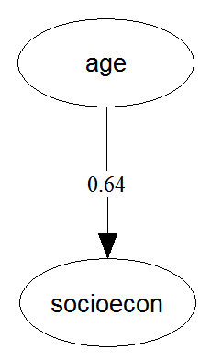
normal copula
r _{socioecon age}
(rank correlation)

Slide 17
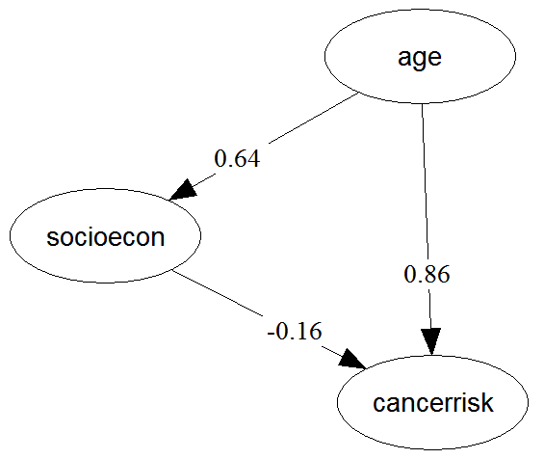
r _{socioecon age}
normal copula
r _{socioecon age}
(rank correlation)

Slide 18
r _{socioecon age}
❷
❶
normal copula
r _{socioecon age}
(rank correlation)

Slide 19
r _{socioecon age}
❷
r _{cancerrisk age | socioecon}
_{(conditional rank correlation)}
❶
normal copula
r _{socioecon age}
(rank correlation)
r _{cancerrisk socioecon}

Slide 20
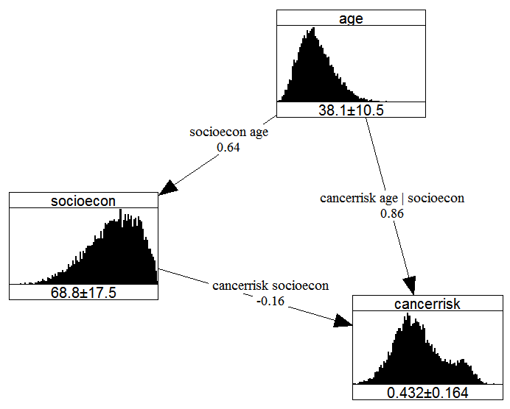
Continuous
Non-Parametric
Bayesian Network

Slide 21
Uninet walkthrough

Slide 22
C++
C#
Delphi
VB.net
UninetEngine.dll
MATLAB
R
Octave
VBA (Excel)

Slide 23
The UninetEngine COM library is an extensive, object oriented, language-independent library: over seventy
classes, over 500 methods (functions)
There are different Bayes net samplers accessible through the programmatic interface (e.g. the pure
memory sampler used by UoM)
There are a number of extra facilities accessible through the programmatic interface (e.g. a Bayes net can be
specified via a product-moment correlation matrix)
Uninet is free for academic use

Slide 24
Examples of NPBN projects with Uninet
Risk analysis applications
  Earth dams safety in the State of Mexico
  Linking PM2.5 concentrations to stationary source emissions
  Causal models for air transport safety (CATS)
  The benefit-risk analysis of food consumption (BENERIS)
  The human damage in building fire
  Platypus: Shell (risk analysis for chemical process plants)
Reliability of structures
  Bayesian network for the weigh in motion system of the Netherlands (WIM)
Properties of materials
  Technique for probabilistic multi-scale modelling of materials
Dynamic NPBNs
  Permeability field estimation
  Traffic prediction in the Netherlands
Ongoing
  Filtration techniques (wastewater treatment plants)
  Flood defences
  Train disruptions
  National Institute for Aerospace, Virginia USA: BbnSculptor
  Wildfire Regime Simulators for UniMelb (FROST)

Slide 25
CATS

Slide 26
BENERIS

Slide 27
Human Damage in Building Fire

Slide 28
WIM

Slide 29
printf("thank you!");

Slide 30
References:
For examples of major projects mentioned in this talk which are using/have used NPBNs in Uninet:
Ale, B., Bellamy, L., Cooke R.M., Duyvis, M., Kurowicka, D., Lin, P., et al. (2008) Causal model for air transport safety. Final Rep. ISBN 10: 90 369 1724-7, Ministerie van Verkeer en Waterstaat
Ale, B., Bellamy, L., Cooper, J., Ababei, D., Kurowicka, D., Morales-Napoles, O., et al. (2010) Analysis of the crash of TK 1951 using CATS. Reliability Engineering and System Safety, 95: 469–477
Jesionek, P., Cooke, R. (2007) Generalized method for modelling dose–response relations—application to BENERIS project. Technical report. European Union project
D. Hanea, D., Jagtman, H., Ale B. (2012) Analysis of the Schiphol cell complex fire using a Bayesian belief net based model. Reliability Engineering and System Safety, 100: 115–124
Morales-Nápoles, O., Steenbergen R. (2014) Analysis of axle and vehicle load properties through Bayesian networks based on weigh-in-motion data, Reliability Engineering and System Safety, 125: 153–164
Morales-Nápoles, O., Steenbergen, R. (2015) Large-scale hybrid Bayesian network for traffic load modelling from weigh-in-motion system data. Journal of Bridge Eng ASCE, accepted for publication, 2015.
For (other) examples of major projects which are using/have used NPBNs in Uninet, see the following synthesis paper and the references therein:
Hanea, A.M., Morales-Napoles, O., Ababei, D. (2015) Non-parametric Bayesian networks: Improving theory and reviewing applications. Reliability Engineering & System Safety, 144: 265–284

Slide 31
References:
For further exploring NPBNs, see:
Kurowicka, D. , Cooke, R.M. (2011) Vines and continuous non-parametric Bayesian belief nets, with emphasis on model learning, Ch. 24 in Klaus Boecker (ed.) Re-Thinking Risk Measurement and Reporting, Uncertainty, Bayesian Analysis and Expert Judgement, pp 273-294, Risk Books, London
Hanea, A.M., Kurowicka, D., Cooke, R.M., Ababei, D. (2010) Mining and visualising ordinal data with non-parametric continuous BBNs. Computational Statistics and Data Analysis, 54(3): 668-687
Cooke, R.M., Hanea, A.M., Kurowicka, D. (2007) Continuous/Discrete Non Parametric Bayesian Belief Nets with UNICORN and UNINET, In Proceedings of Mathematical Methods in Reliability, Glasgow, Scotland.
Hanea, A.M., Kurowicka, D., Cooke, R.M. (2006) Hybrid method for quantifying and analyzing Bayesian belief nets. Quality and Reliability Engineering International 22(6): 709-729

