Slide 1
2015 ABNMS Conference
Application of Bayesian Networks in Urban Growth Models
© 2015, Sizztech Pty Ltd

Slide 2
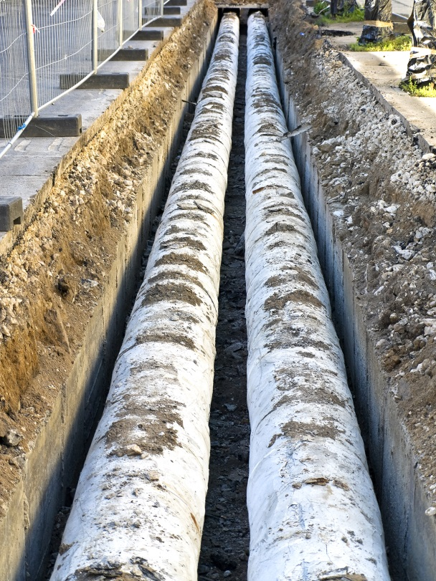
The Problem
  Majority of infrastructure projects at Local Government level
  Long term capital works programs to service future urban growth
    Identify new infrastructure and upgrades to service urban growth for next 20 years
    Required for all “trunk” infrastructure networks (water, sewerage, transport, stormwater, open space)
    Associated financial models required to fund and deliver infrastructure
  Requires reliable urban growth models
  Producing urban growth models is difficult
    Manually intensive typically taking 5-8 man months with external consultant involvement
    No consist methodology or guidelines
    Utilises broad assumptions
    Models that are inaccurate, difficult to modify and prone to human error

Slide 3
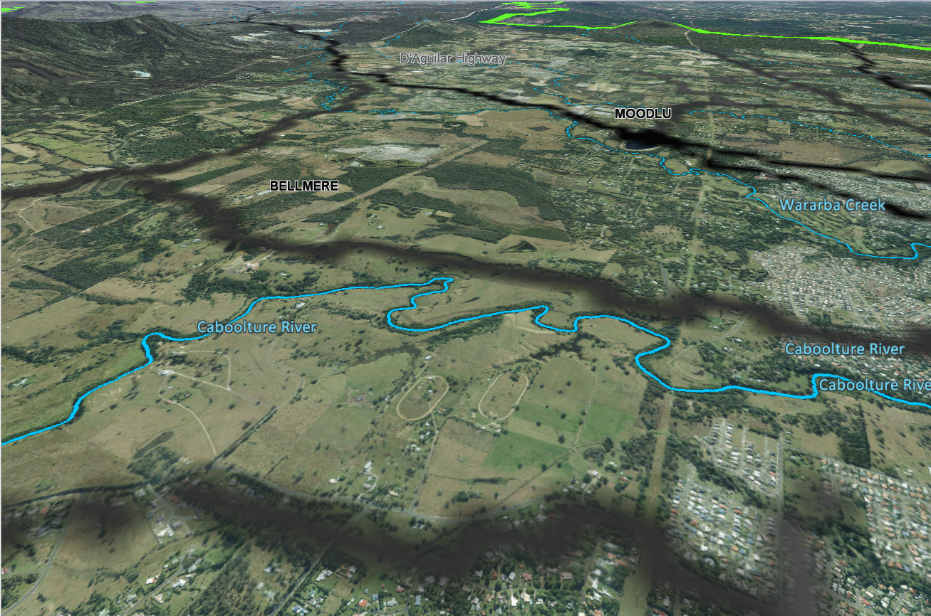
Forecaz Modeller
  Forecaz Modeller developed to address this problem
    Geospatial modelling tool that automates the generation of residential and non- residential development growth for a region
    Provides demand growth assumptions for infrastructure networks and calculates infrastructure charges revenue generated by the development.
    Geospatially aggregates and views forecast model data
    Predicts
      What type of growth
      Location of growth
      How much growth
      When will it occur
    When is important
    $15M project deferred 1yr can result in $1M of savings

Slide 4
Forecaz Modeller Inputs

Slide 5
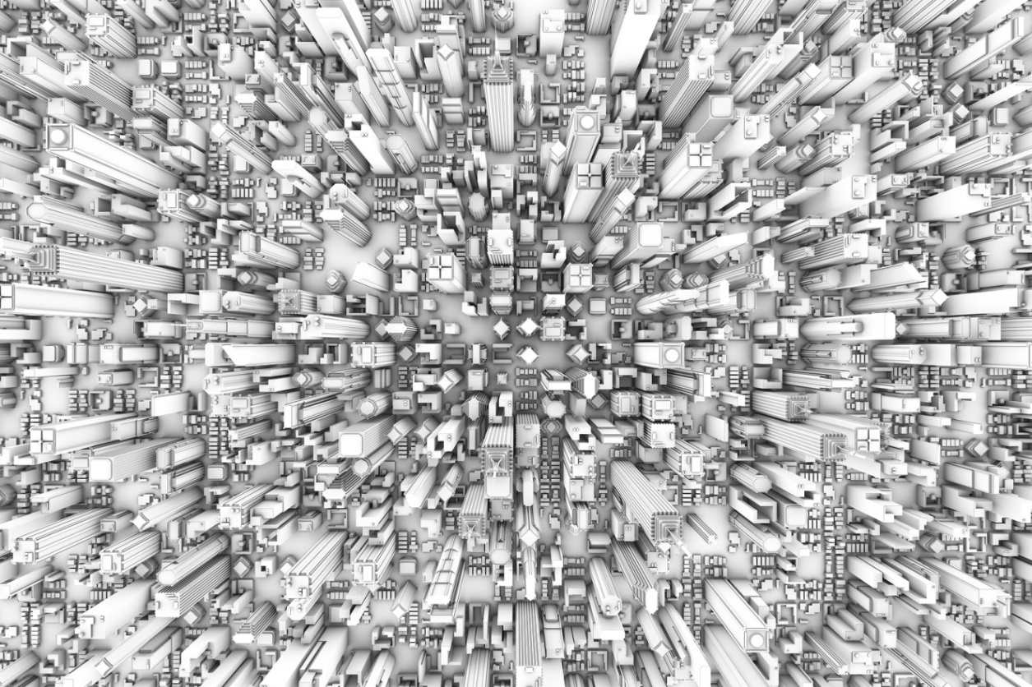
Forecaz Modeller
Determine Ultimate and Best Use
  Use planning zone density provisions and constraints to determine the ultimate development that can be achieved on land parcels.
  Compare existing baseline use with ultimate use to determine highest and best use.
  Determines if land parcel can be developed and the quantum of development.

Slide 6
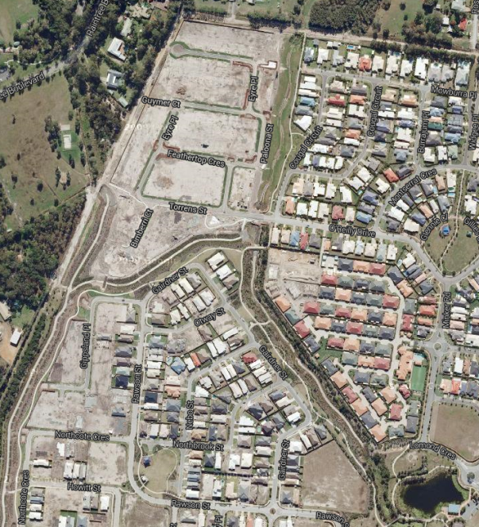
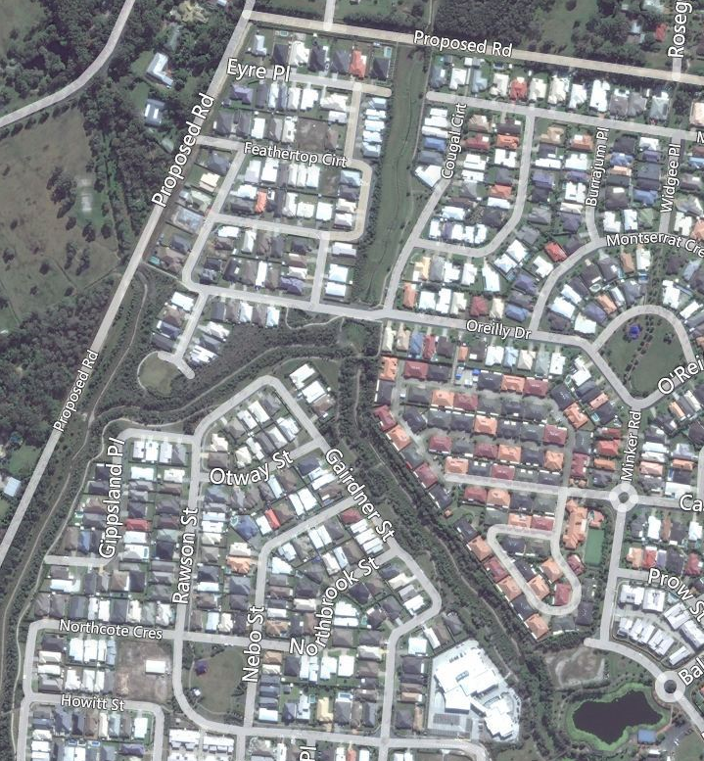
Forecaz Modeller
Sequence Development
  Utilise population and m2GFA growth projections as “control” targets for residential and non-residential development growth at specified projection years.
  Modeller employs a Development Desirability Index (DDI) indicator of the desirability for a developer to develop a land parcel.
  Utilise DDI to allocate and sequence developable land parcels to ultimate full development within projection years until control targets are reached.
Develop land parcels with highest DDI until res & non-res control targets reached for a projection year

Slide 7
Modeller’s BN
Why Bayesian Networks
  Utilises a BN Model to describe a predictive development algorithm that determines a land parcel’s Development Desirability Index
  Why use Bayesian Networks?
    Graphical models that have a clear schema and conditional probabilities that are easily understandable by non-experts
    BNs incorporate the uncertainty of expert knowledge
    Primary users are Urban Planners, safe to assume no Post Grad Mathematical Degree to maintain complex predictive models
    The methodology used to determine growth assumptions needs to be public available and understood by a lay-person
    The BN tools are mature, have a strong community, well supported and documented and have a comprehensive API

Slide 8
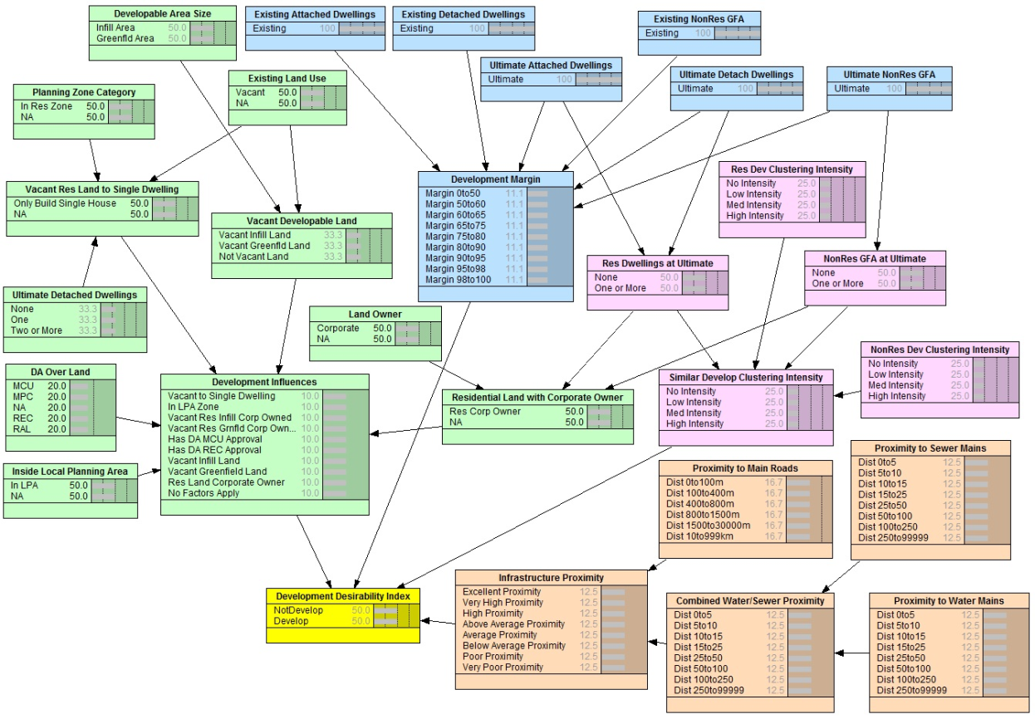
Modeller’s BN
Bayesian Network Submodules
  Development Margin
  Development Influences
Infrastructure Proximity
Similar Development Clustering

Slide 9
Modeller’s BN
Assumptions
  Only land parcels that can be developed are presented to the BN Model
    No BN consideration for: flooding, reserves, fully developed land, etc.
  No accounting for proximity to Community Facilities (i.e. shops, parks, schools)
    Assumed these factors taking into consideration when local governments construct their planning schemes and master plans
  No environment considerations are provided for by the BN Model
    Development constraints are applied through a “constraints” GIS layer by the Modeller
    Only parcels with developable area are presented to the BN Model

Slide 10
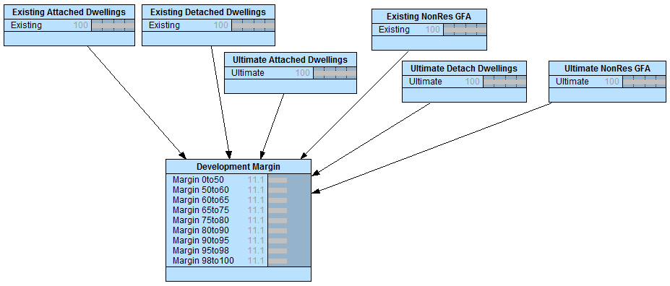
Modeller’s BN
Development Margin Submodule
  Calculates the development margin being:
    Ultimate Development – Existing Development
    Ultimate Development
  Node discretisation has been structure to transpose development margin to Development Yield. “Margin 0to50” represents poor yield of less than 200%
  Development Yield is a primary development factor. High yield -> high probability of development.

Slide 11
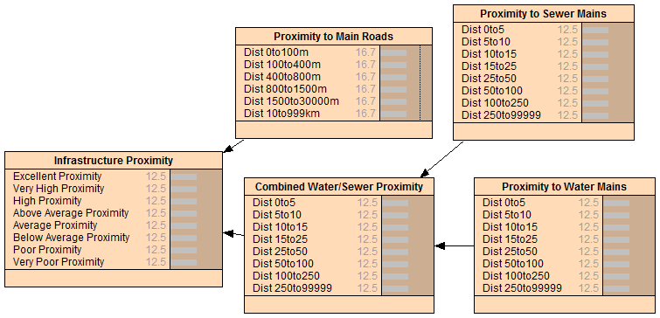
Modeller’s BN
Infrastructure Proximity Submodule
  Combines proximity to Water, Sewerage and Main Roads infrastructure into a single distance state representing proximity to network infrastructure.
  The node is weighted towards the proximity to water mains. A water connection is required, before a Land Parcel can have a sewerage connection.
  Infrastructure Proximity is a primary development factor. Developers face significate costs to expand trunk infrastructure to service their development.

Slide 12
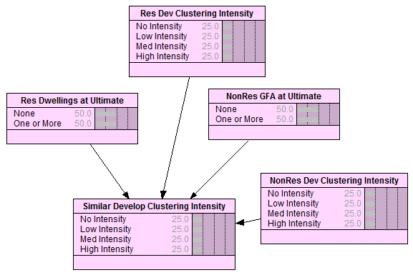
Modeller’s BN
Similar Development Clustering Submodule
  Represents a simular development clustering/precedence within 100m from boundary of a land parcel.
  This node combines the states of residential and non-residential simular development clustering
  Only the clustering types (res / non-res) that matches the land parcel’s ultimate development are considered.

Slide 13
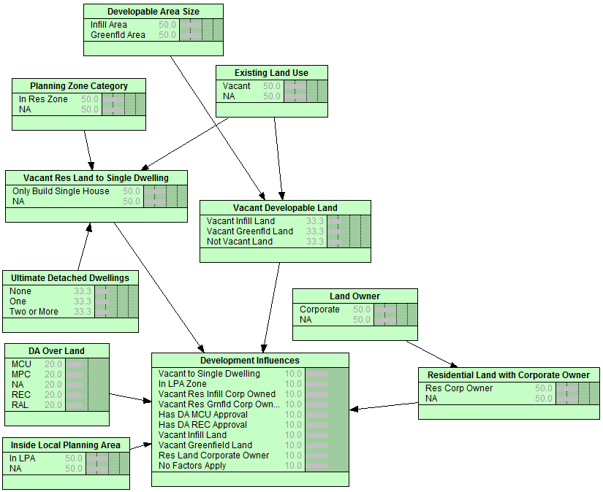
  Modeller’s BN
  Development Influences Submodule
  This node combines the factors that influence development from its various input nodes and weights them as discrete states for input into the Development Desirability Index node

Slide 14
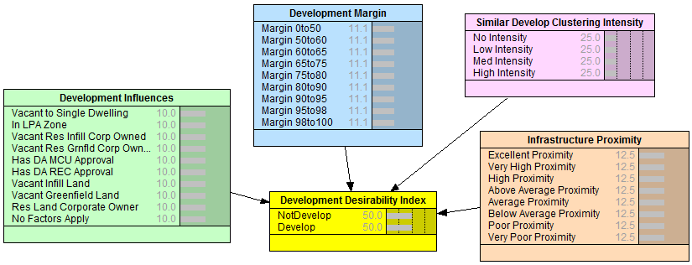
Modeller’s BN
Development Desirability Index Node
  This Node contains the Development Desirability Index (DDI) for the Land Parcel.
  Heavy weighting is given to Development Margin and Infrastructure Proximity
  The highest DDI occurs when Development Influences has a state of “Vacant to Single Dwelling”. Represents vacant land created from a recent sub-division.
  Forecaz Modeller extracts the DDI from the BN Model after: populating all nodes; computing any equations within model; compiling the model to obtain the model’s beliefs which produces the DDI for a developable land parcel.

Slide 15
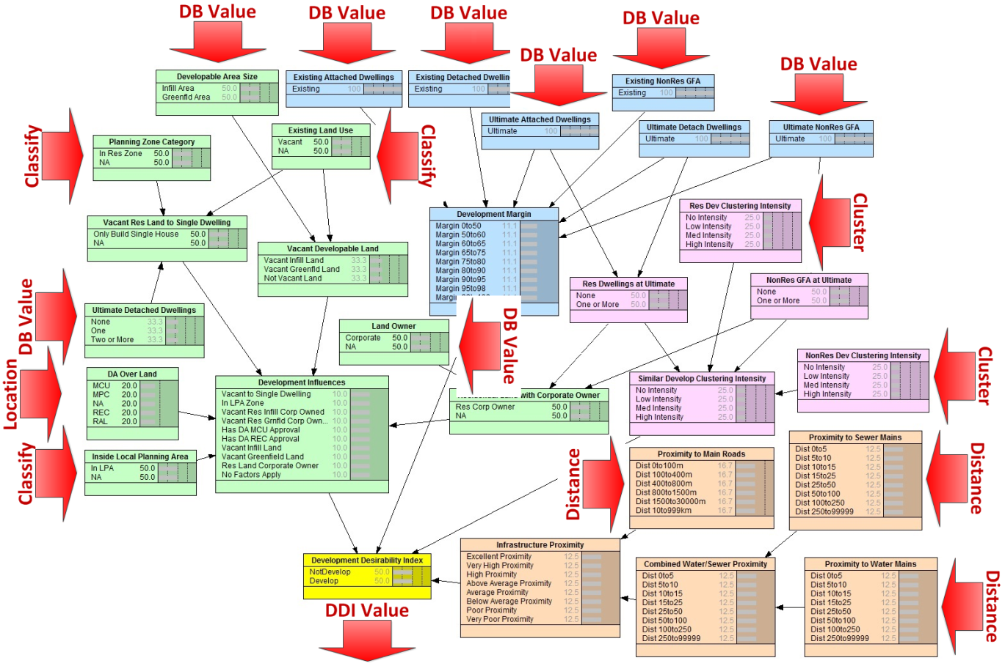
BN Integration
Overview
  The BN nodes are populated by extracting and filtering data from the database or performing spatial operations.
  The Modeller provides computation methods that can be configured to extract and correctly format data for nodes.

Slide 16
BN Integration
Computation Methods
  Development Desirability Index Method
    Identifies the node and state that contains the DDI Value
  Database Value Method
    Extracts and filters values from the database
  Distance Method
    Minimum distance between parcel and GIS layer features
  Located Method
    Parcel located within a GIS feature returns an attribute from feature
  Classify Method
    Classify various values of an attribute in an intersected GIS feature into a single classification value
  Cluster Method
    Count of parcels meets Res/Non-Res thresholds within specified distance from parcel

Slide 17
Next Steps
  Used the modeller to build urban growth models for:
    Noosa Shire Council
    Sunshine Coast Council
  Currently developing Moreton Bay Regional Council model
  Take 3 data sets and apply leaning from data to further validate the BN
  Use learning to expand the nodes (i.e. distance to bus stops/train stations) and evaluate sensitivity
  Investigate the use of Decision Networks

Slide 18
Thank You

